Slide 1


Art . Design . Technology . Culture . Arts in Health . Arts in Education . Media

Slide 2


WELCOME TO OUR CREATIVE COMMUNITY
Art . Design . Technology . Culture . Arts in Health . Arts in Education . Media

Slide 3
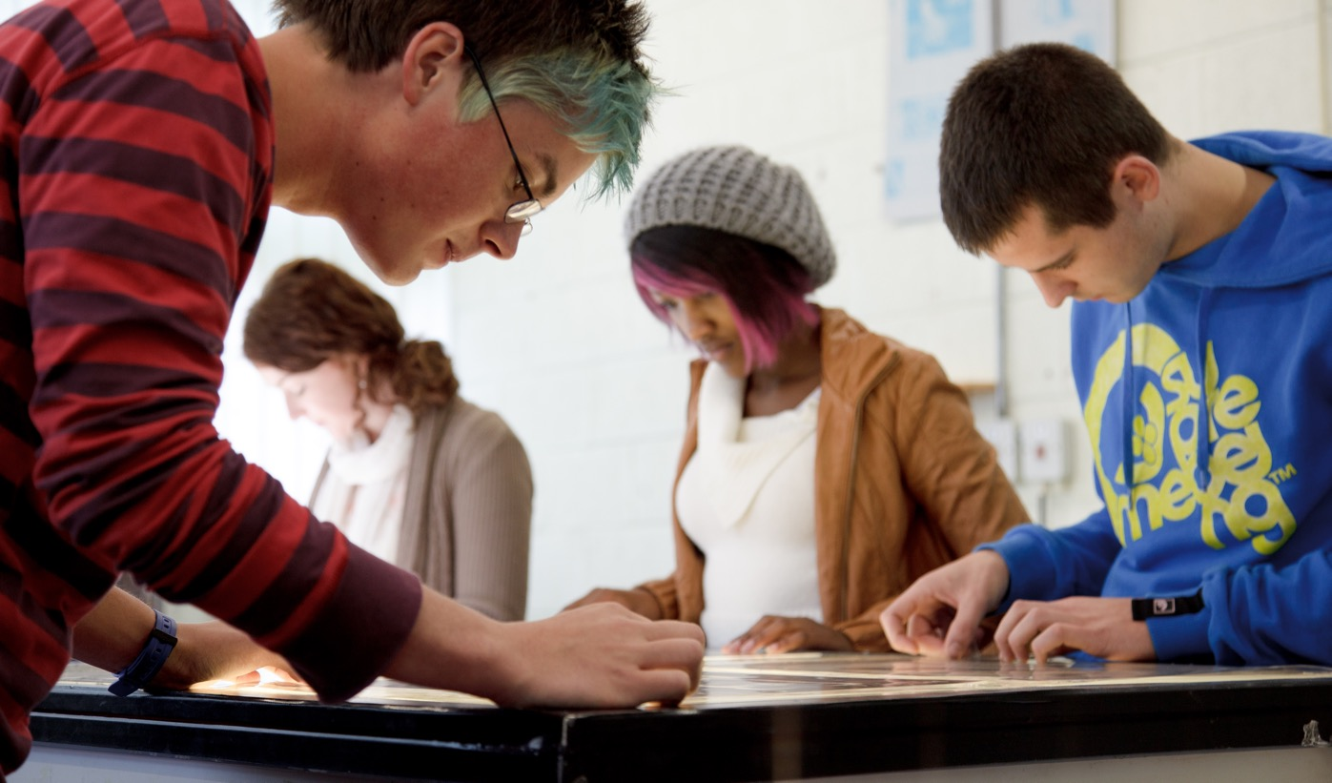
WHO WE ARE
Crawford College of Art & Design (CCAD) is a vibrant multi-campus College, which has been providing education in the arts for more than 100 years.
Crawford graduates are among Ireland’s top artists, curators, designers, media practitioners, art therapists and art educators.

Slide 4
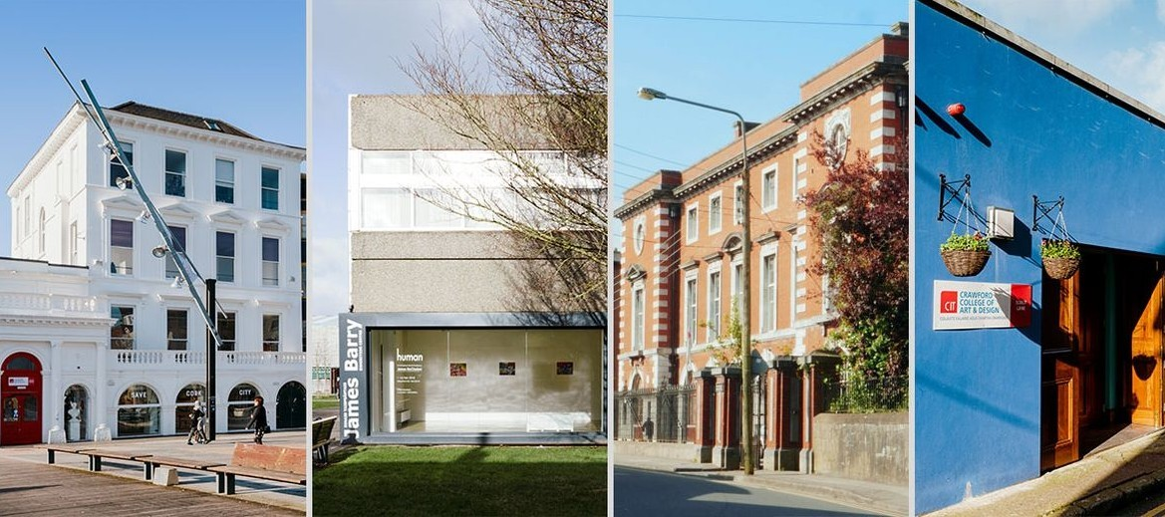
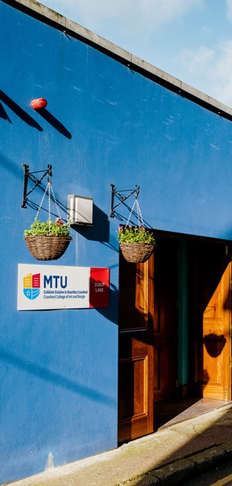
OUR DEPARTMENTS
The Crawford consists of three Departments, based in Sharman Crawford Street, Bishopstown Campus, 46 Grand Parade and Envision Centre, Sober Lane.
Fine Art & Applied Art
Media Communications
Arts in Health & Education

Slide 5
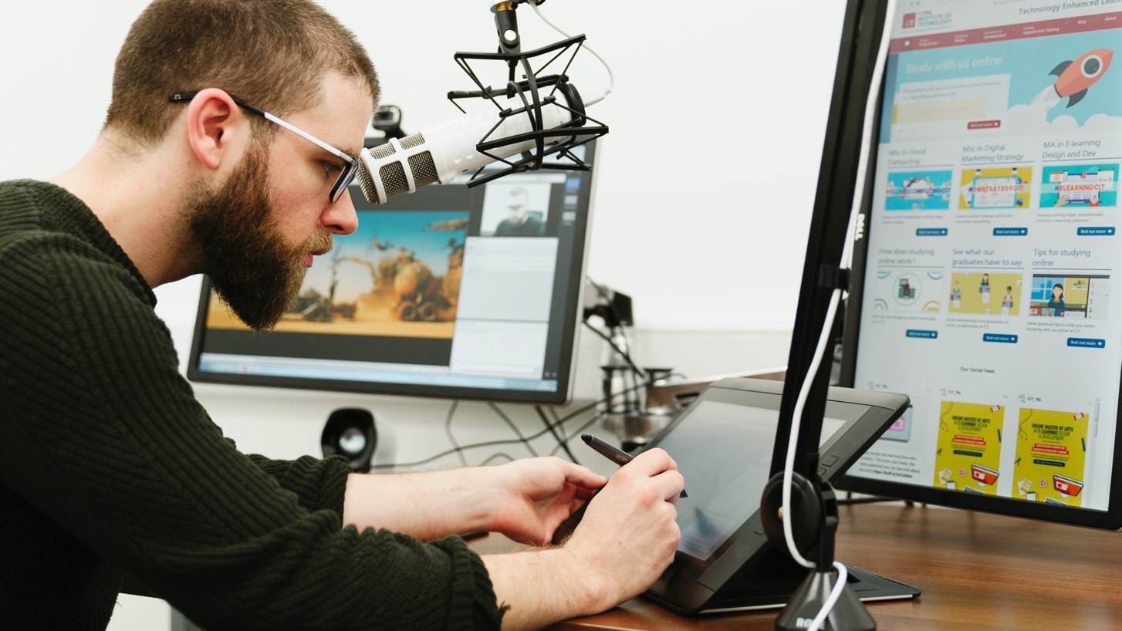
OUR FACILITIES
Facilities include
Media and virtual reality computer labs
Ceramic, Glass and Textile Workshops
Photography & Video Studios
Print and Metal Workshops
Student Studio Spaces
Design Studios
Gallery & Gallery trial Spaces
Lecture Theatres and Library

Slide 6
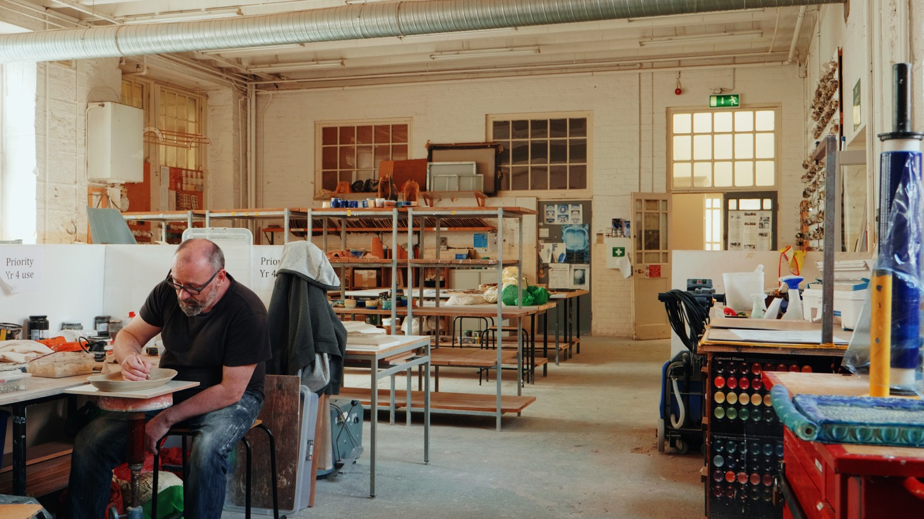
OUR FACILITIES
Facilities include
Media and virtual reality computer labs
Ceramic, Glass and Textile Workshops
Photography & Video Studios
Print and Metal Workshops
Student Studio Spaces
Design Studios
Gallery & Gallery trial Spaces
Lecture Theatres and Library

Slide 7
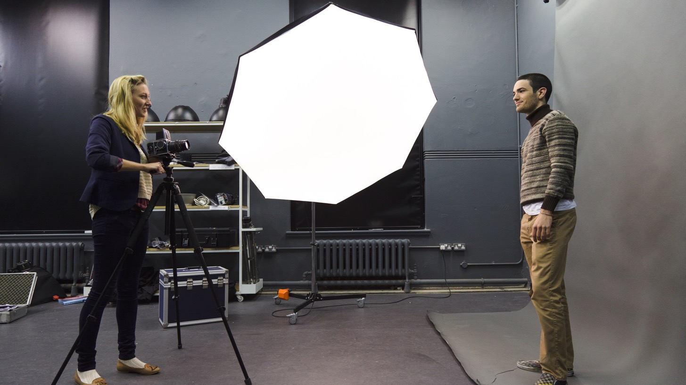
OUR FACILITIES
Facilities include
Media and virtual reality computer labs
Ceramic, Glass and Textile Workshops
Photography & Video Studios
Print and Metal Workshops
Student Studio Spaces
Design Studios
Gallery & Gallery trial Spaces
Lecture Theatres and Library

Slide 8
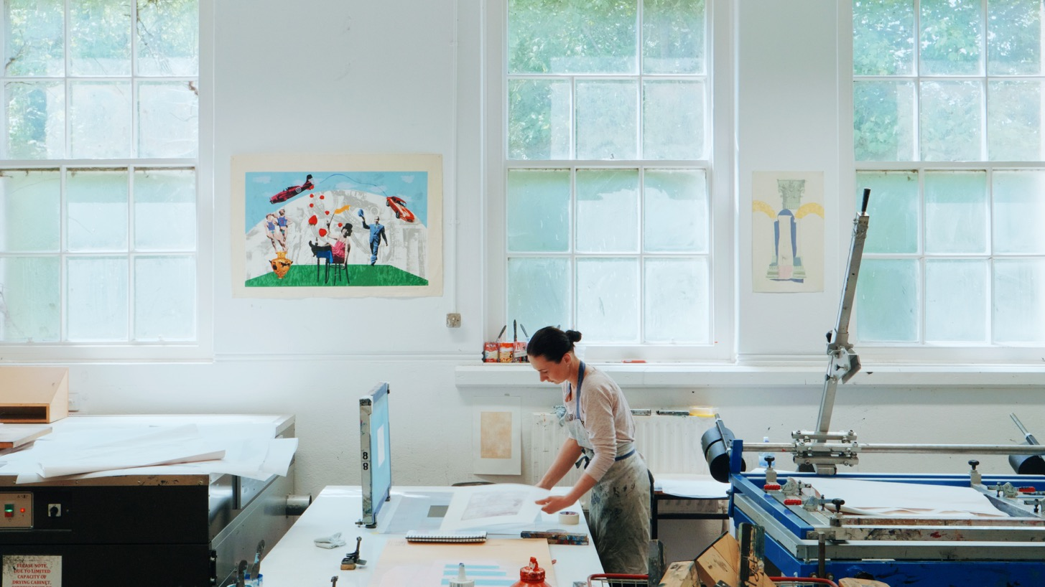
OUR FACILITIES
Facilities include
Media and virtual reality computer labs
Ceramic, Glass and Textile Workshops
Photography & Video Studios
Print and Metal Workshops
Student Studio Spaces
Design Studios
Gallery & Gallery trial Spaces
Lecture Theatres and Library

Slide 9
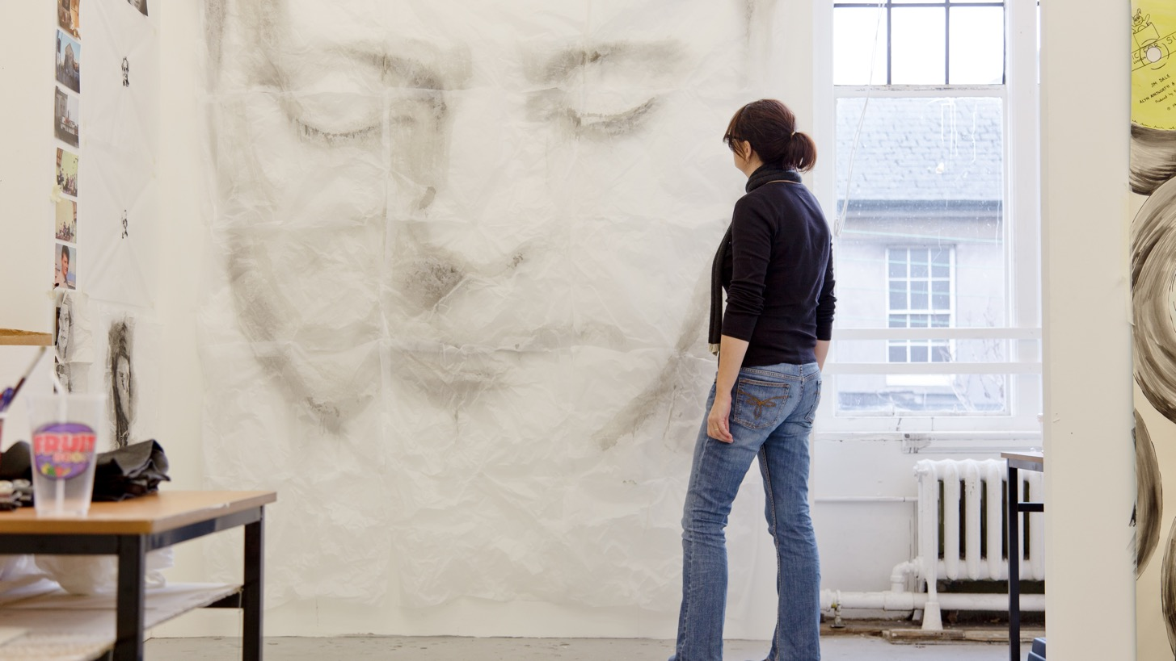
OUR FACILITIES
Facilities include
Media and virtual reality computer labs
Ceramic, Glass and Textile Workshops
Photography & Video Studios
Print and Metal Workshops
Student Studio Spaces
Design Studios
Gallery & Gallery trial Spaces
Lecture Theatres and Library

Slide 10
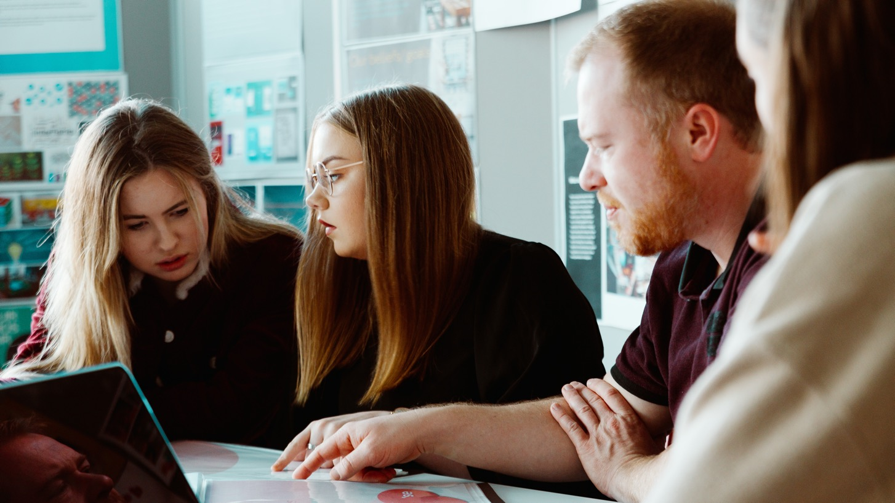
OUR FACILITIES
Facilities include
Media and virtual reality computer labs
Ceramic, Glass and Textile Workshops
Photography & Video Studios
Print and Metal Workshops
Student Studio Spaces
Design Studios
Gallery & Gallery trial Spaces
Lecture Theatres and Library

Slide 11
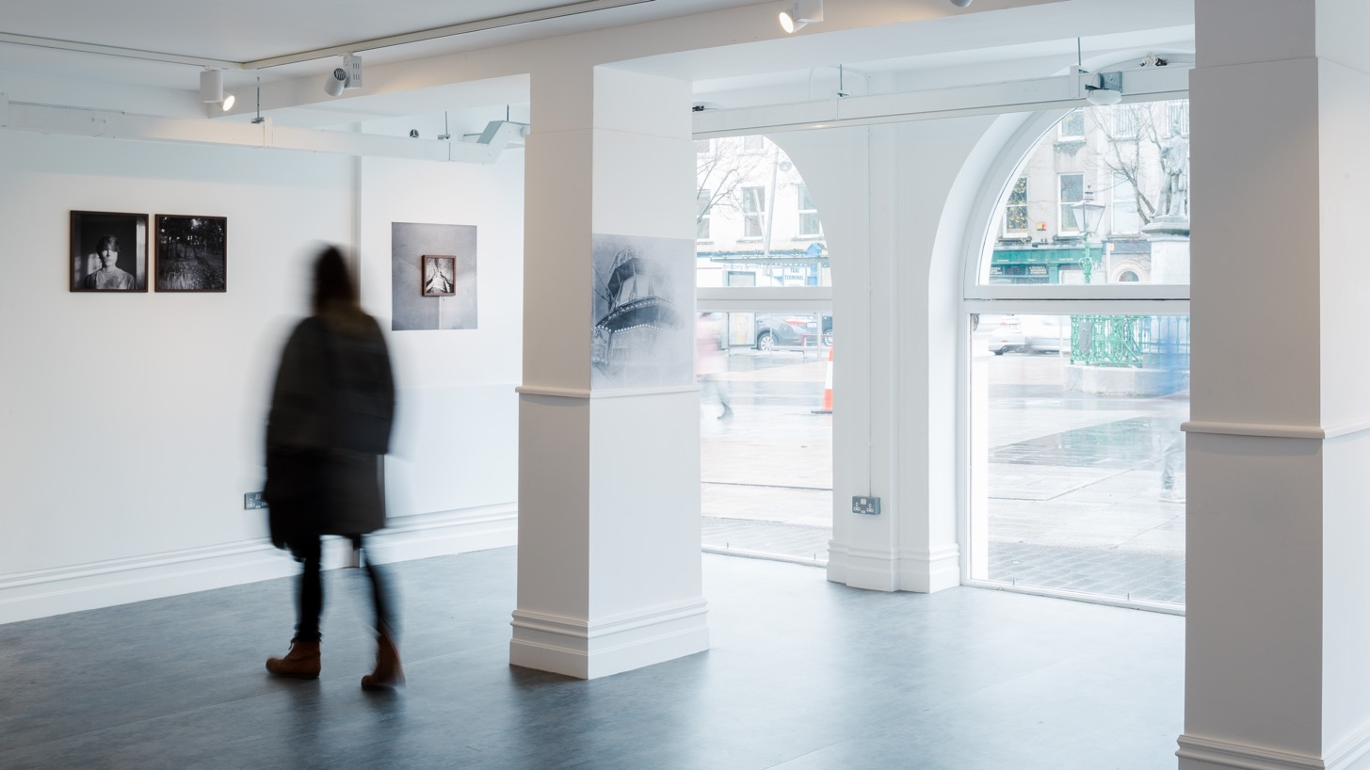
OUR FACILITIES
Facilities include
Media and virtual reality computer labs
Ceramic, Glass and Textile Workshops
Photography & Video Studios
Print and Metal Workshops
Student Studio Spaces
Design Studios
Gallery & Gallery trial Spaces
Lecture Theatres and Library

Slide 12

OUR FACILITIES
Facilities include
Media and virtual reality computer labs
Ceramic, Glass and Textile Workshops
Photography & Video Studios
Print and Metal Workshops
Student Studio Spaces
Design Studios
Gallery & Gallery trial Spaces
Lecture Theatres and Library

Slide 13
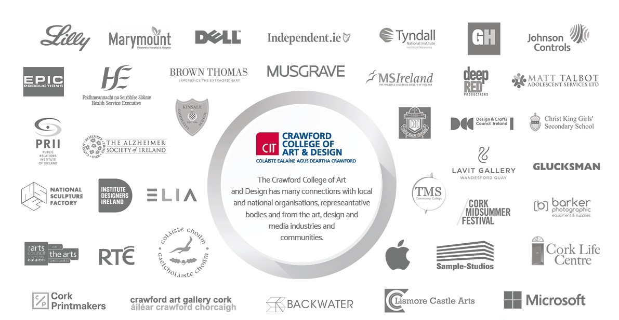

OUR Partners

Slide 14


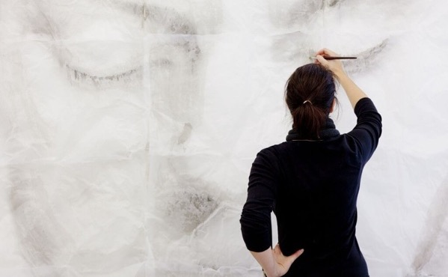
THE CRAWFORD DEPARTMENTS
DEPARTMENT OF MEDIA COMMUNICATIONS
BA (Hons) Creative Digital Media
BA (Hons) Visual Communications
BA (Hons) Photography with New Media
MAs & Special Purpose Awards
DEPARTMENT OF FINE ART & APPLIED ART
BA (Hons) Fine Art
BA (Hons) Contemporary Applied Art
MAs & Special Purpose Award
DEPARTMENT OF ARTS IN HEALTH & EDUCATION
MA ART THERAPY
PROFESSIONAL MASTERS OF EDUCATION (Art and Design)
MA ARTS & Engagement
Special Purpose Awards
Notes:
The Crawford College consists of three departments
(Click to reveal departments with listed courses)

Slide 15

TRANSFERABLE SKILLS FOR ART & DESIGN
confidence
Open mindedness
discipline
OBSERVATION
Time management
collaboration
SELF - EXPRESSION
FOCUS
CREATIVITY
negotiation
perseverance
risk - taking
Critical thinking
Progamme

Slide 16
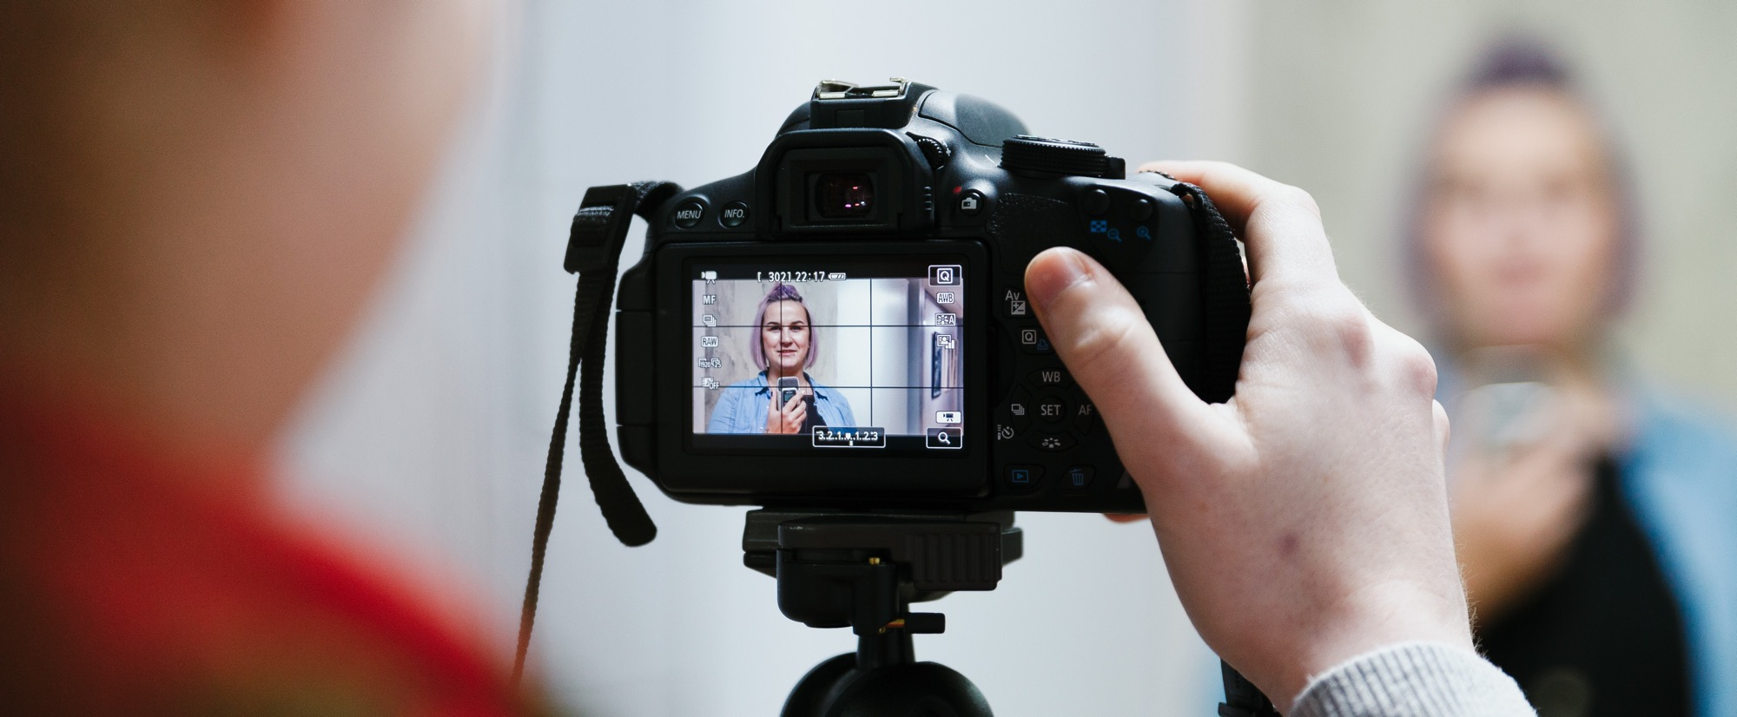
BA (Hons) CREATIVE DIGITAL MEDIA
The Creative Digital Media programme combines the creativity of art and design with the skills and knowledge of computer technologies and programming to create interactive digital media products.

Slide 17
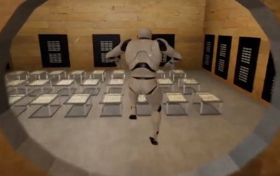
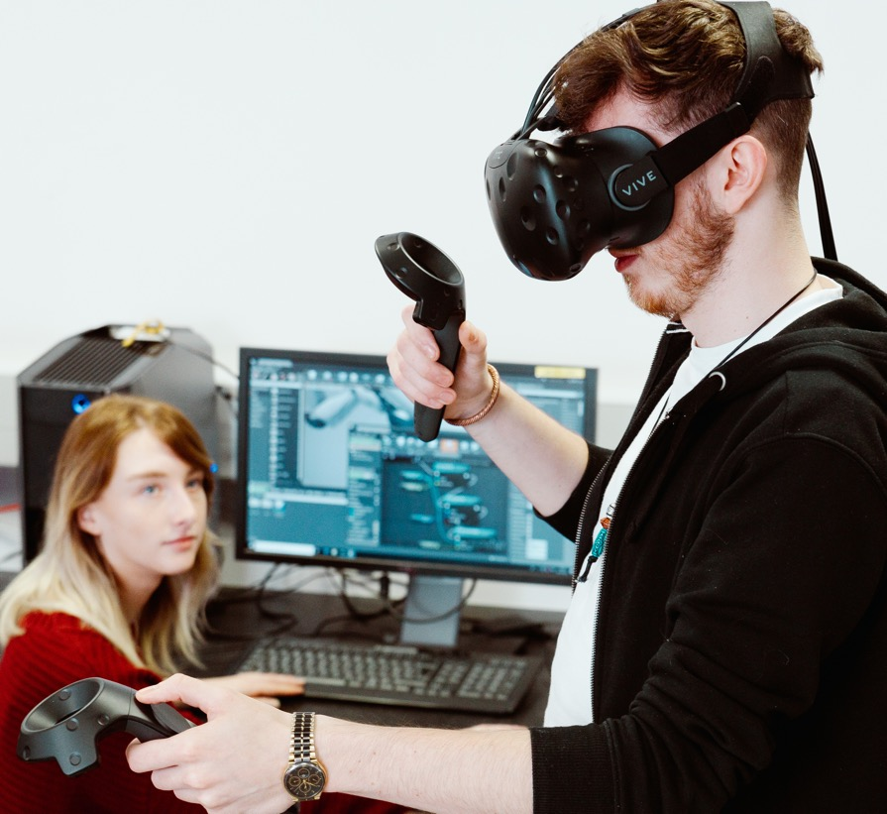
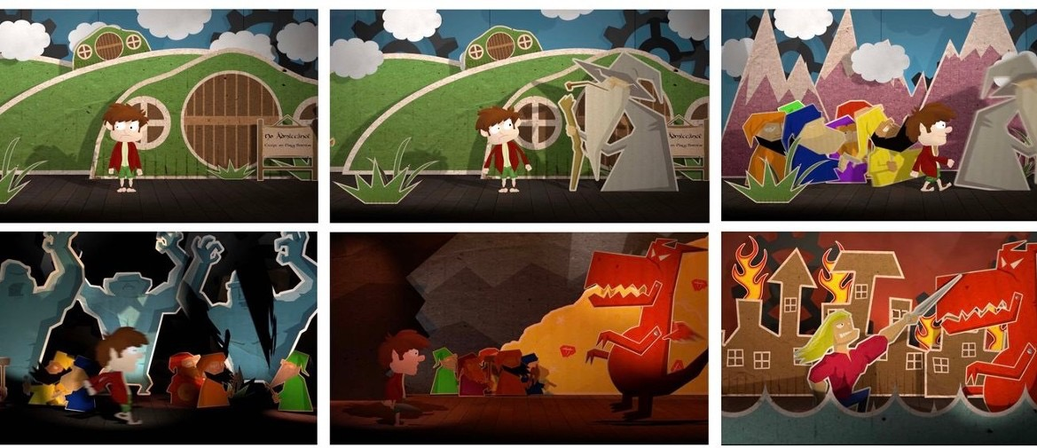
BA (Hons) CREATIVE DIGITAL MEDIA
WHAT YOU Do
Video/Film Making
Game design
Music technology
Web Design & Development
Business & Marketing
Animation
Virtual reality
User experience (UX)
Notes:
Creative Digital Media is a fast evolving and dynamic industry. At MTU we prepare students by offering a variety of modules including
Digital media design
Film & Video production
Music technology
Computer programming
Digital marketing & Media business
Animation & Motion Graphics
Virtual reality Game Design
User experience (UX)
User interface design (UI)
Digital culture
& much more!

Slide 18
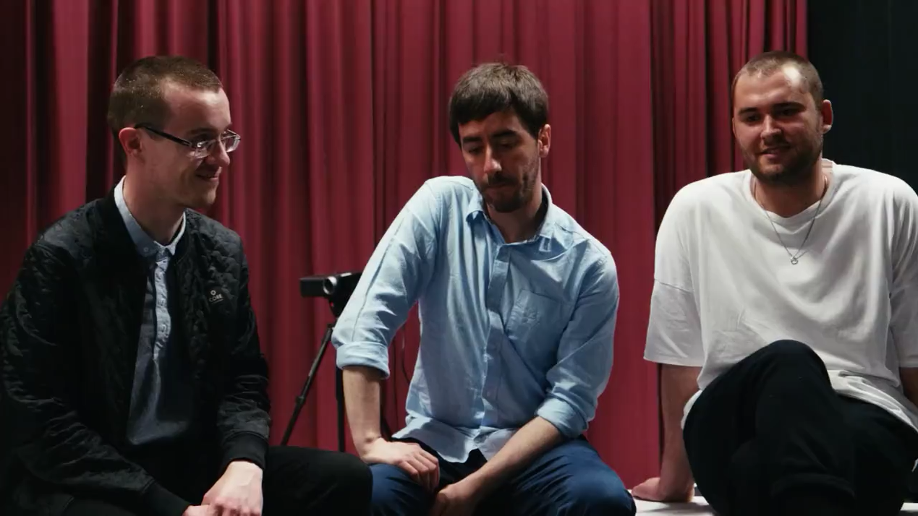
BA (Hons) CREATIVE DIGITAL MEDIA
FINAL
YEAR PROJECT
TADHG MCNEALY, PAUL SAVAGE & SEAN CONROY
Creative Digital Media
This is an interactive, audio visual live show.

Slide 19
BA (Hons) CREATIVE DIGITAL MEDIA
Career Opportunities
• Web Design • Animation
• Game Design • Virtual Reality Designer • UX UI Designer • Music Technology • Motion Graphics Producer • Visual Effects Artist
• Film Maker • Studio Director
Notes:
Creative Digital Media at MTU prepares students for a wide range of careers from game design to filmmaking, business, music technology and more.

Slide 20
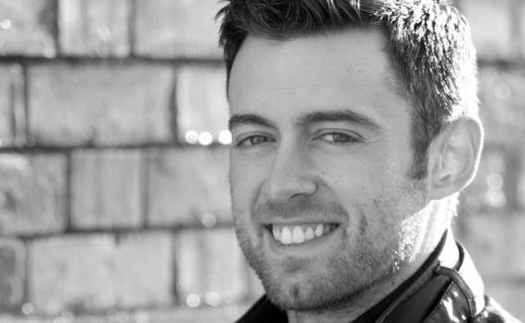
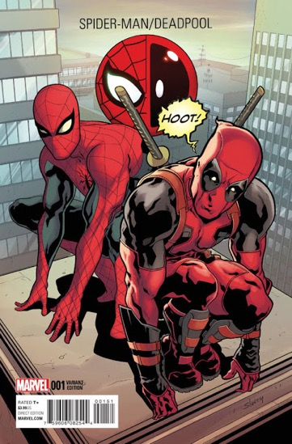
BA (Hons) CREATIVE DIGITAL MEDIA
GRADUATE Profile
Will Sliney
Comic Book Illustrator
Artist for Marvel's Spider-Man 2099, Avengers + X-Men and many more super hero characters.
Founder of Cork Creative Space, an open studio of full-time professionals working in the freelance digital Industry.

Slide 21

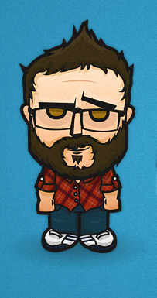
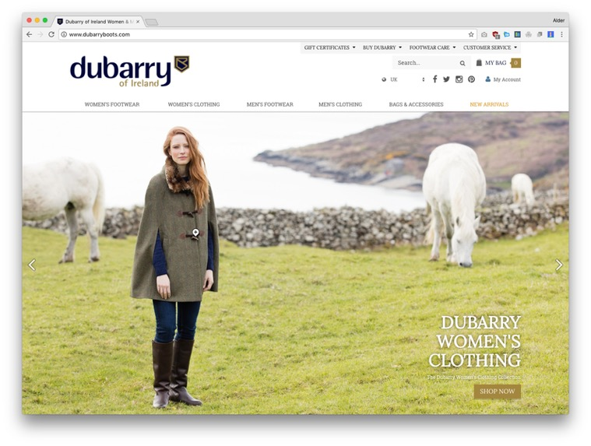
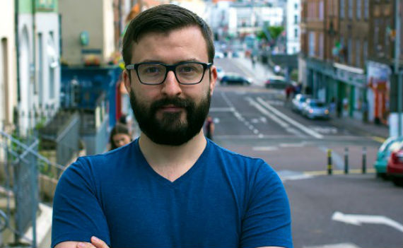
BA (Hons) CREATIVE DIGITAL MEDIA
GRADUATE Profile
Alder Cass
Marketing Technology & Development Lead at Teamwork
Alder is involved in the front-end development of the company website, as well as any other web development needs such as API integrations, data gathering and reporting.

Slide 22

BA (Hons) VISUAL COMMUNICATIONS
Visual Communications encourages you to think creatively and produce new design ideas and concepts. From pitching a design brief to a client to producing design, layout for interface or print content, you will go on a journey to understand who you are as a designer.

Slide 23
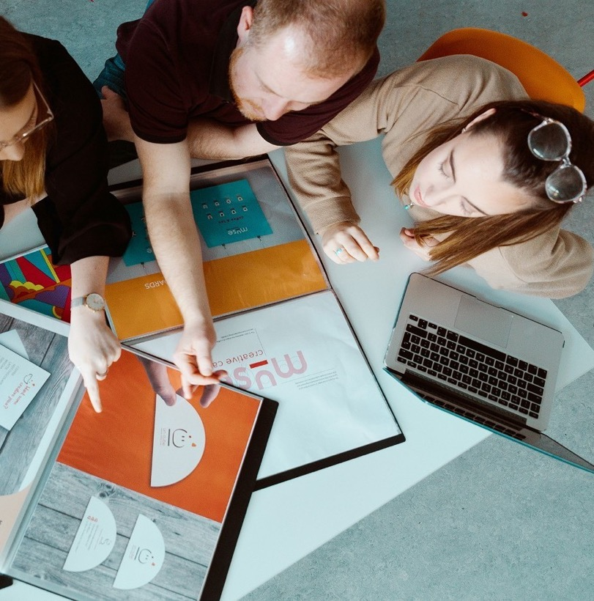
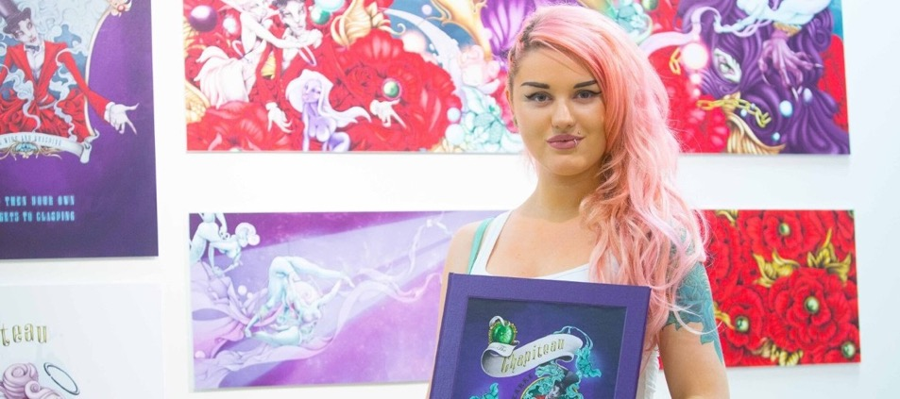

BA (Hons) VISUAL COMMUNICATIONS
WHAT YOU Do
Illustration
Photography
Motion graphics
Branding
Layout & artwork for print
Interface design
Typography
Advertising campaigns
Notes:
Visual Communications focuses on design and illustration for print (magazines, books etc)., packaging, apps and the web.
Layout & artwork for print
Interface design
Motion graphics
Illustration
Photography
Typography
Packaging
Branding
Advertising campaigns

Slide 24
BA (Hons) VISUAL COMMUNICATIONS
Career Opportunities
• Graphic Design • Advertising Executive
• Branding Consulting • Illustrator
• Photography • Typographer
• Comic Book Artist • Web Designer
• Creative Director • Editorial Design
• Entrepreneur

Slide 25
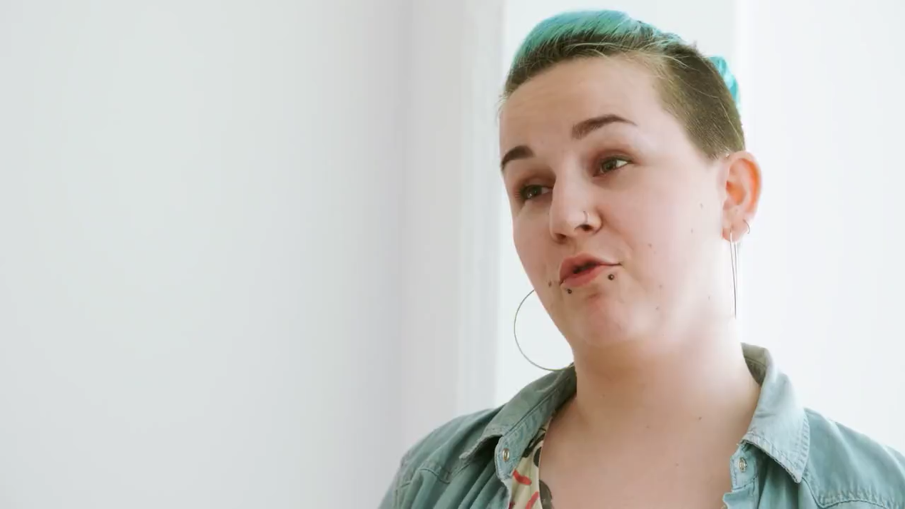
BA (Hons) VISUAL COMMUNICATIONS
FINAL
YEAR PROJECT
MONIKA SYZNKIEWICZ
Visual Communications
Project: Illustrator with a passion for comics. My project is a graphic novel memoir based on my experiences with cancer.

Slide 26
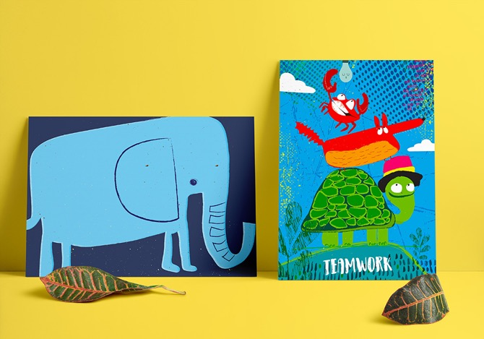
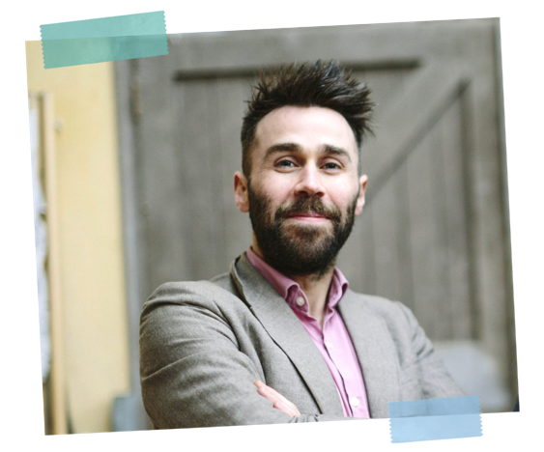
BA (Hons) VISUAL COMMUNICATIONS
GRADUATE Profile
Paul Delaney
Creative Director
Creative Director of a branding Agency establish by Paul called Visible Inc.
Paul creates large-scale graphic artworks for corporate office spaces. He also launched a home furnishing collection in collaboration with Scatterbox.
His artworks have been exhibited and sold throughout Ireland and the UK.

Slide 27
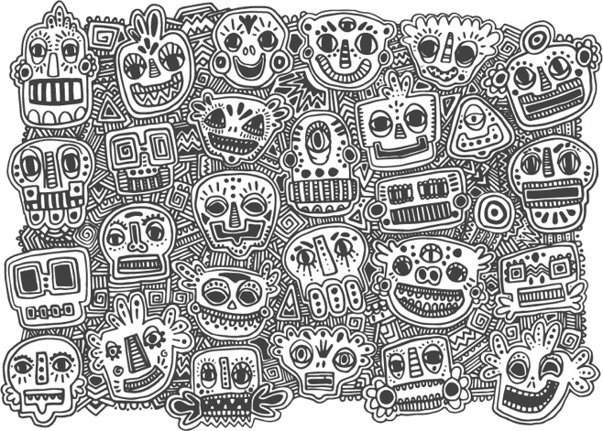
BA (Hons) VISUAL COMMUNICATIONS
GRADUATE Profile
Grace Murray
Senior Graphic Designer
Winner of the Graduate Awards for the Institute of Designers of Ireland in the Illustration Category.
Grace now works as an illustrator for Wavebreak Media, one of the world’s top producers of stock imagery. The images she creates for this company are now some of the top sellers in the Adobe stock site.

Slide 28
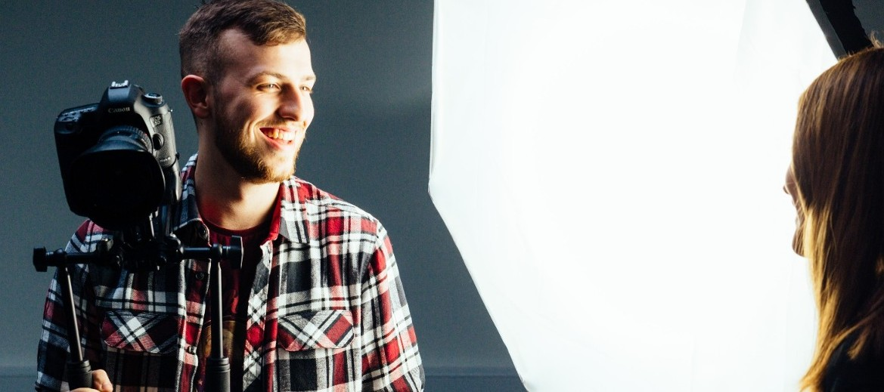
BA (Hons) PHOTOGRAPHY WITH NEW MEDIA
Photography with New Media is an exciting new programme with a distinct professional emphasis. It blends photography, video and new media to prepare students to work creatively and flexibly in a variety of photography, video and media related areas.

Slide 29
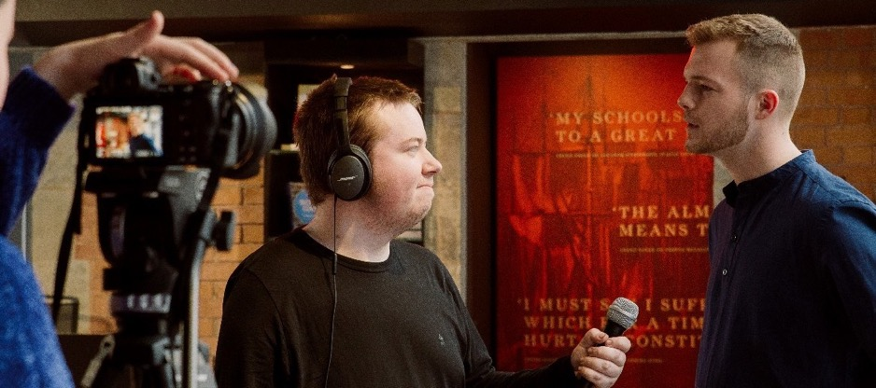
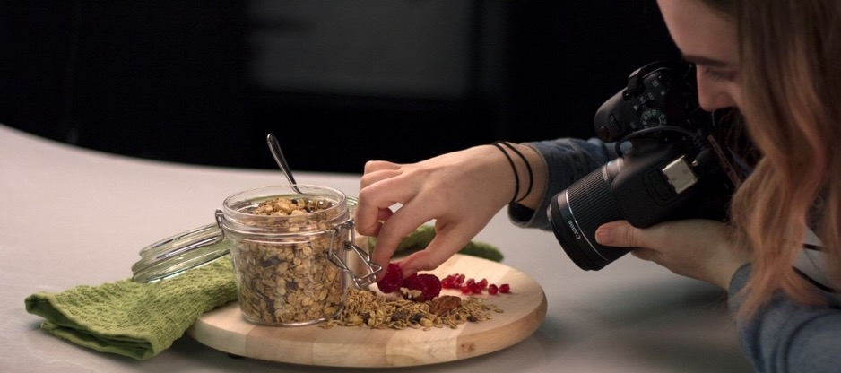
BA (Hons) PHOTOGRAPHY WITH NEW MEDIA
WHAT YOU Do
You will be using the latest and most up-to-date photography, video and media industry software and hardware. You will gain first-hand experience of the realities of the photography profession through an extended professional placement in the third year of the programme.

Slide 30
BA (Hons) PHOTOGRAPHY WITH NEW MEDIA
Career Opportunities
Commercial Photography • Video Production • Fashion Photography
• Clinical and Forensic Photography
• Videography • Film Making • Motion Graphics Production • Video Post-Production • Video Technician
Notes:
Advertising Photography
• Sports Photography
•Video Production
• Fashion Photography
• Events Photography
• Architectural Photography
•Clinical and Forensic Photography
•Videography
• Short Film Making
• Motion Graphics Production
• Video Post-Production \
• Video Technician
• Entrepreneur
• and much more.

Slide 31
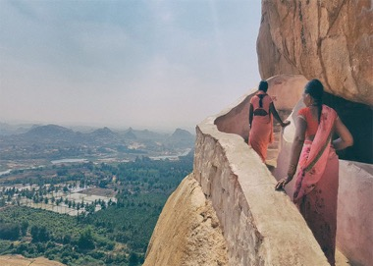
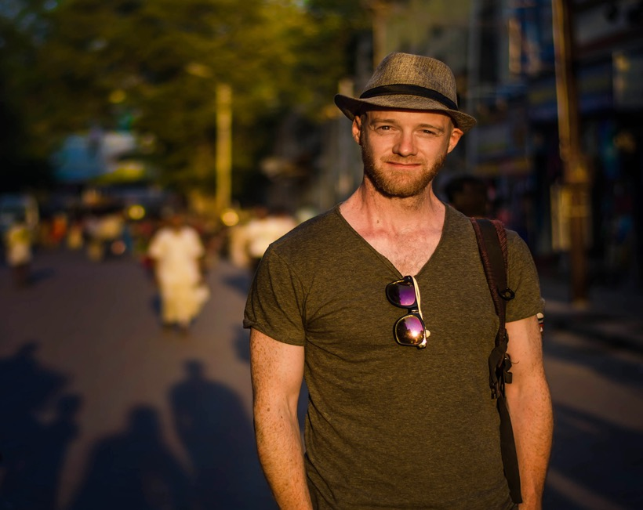
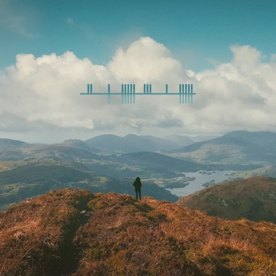
BA (Hons) PHOTOGRAPHY WITH NEW MEDIA
STUDENT Profile
Shaun O’Connor
Director / Writer
Shaun is a graduate of the BA in Multimedia (Retitled: Creative Digital Media). Shaun is now the Extern Examiner of the BA (Hons) in Photography with New Media.
Shaun is a Director/ Writer of Short Films, Television series, Corporate and Music Video’s. He is also an accomplished Photographer.

Slide 32
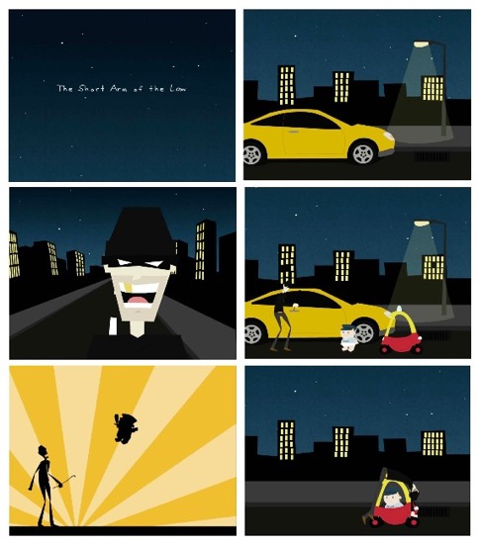
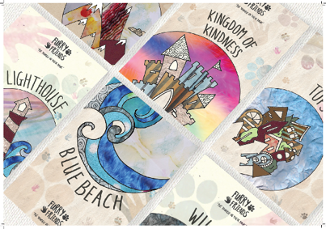
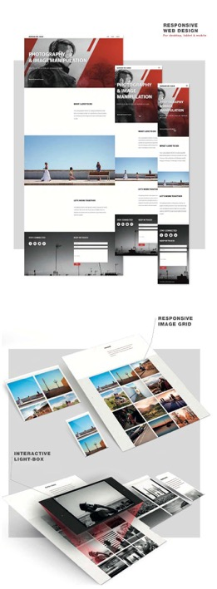
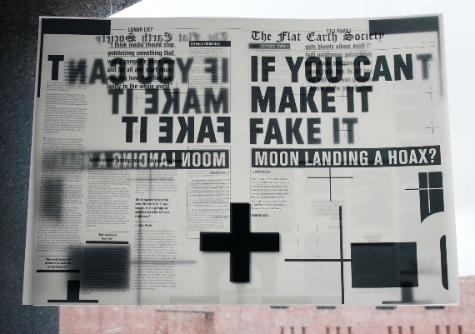

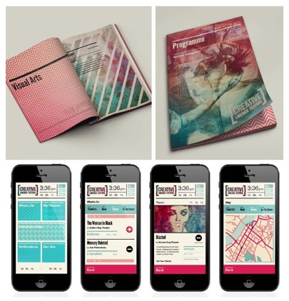
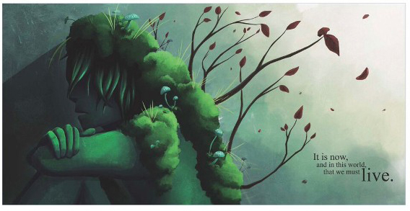
STUDENT SHOWCASE MEDIA COMMUNICATIONS
Student Showcase

Slide 33
BA (Hons) FINE ART
The BA in Fine Art places great importance on introducing students to the professional world of art and achieves this through a high profile visiting lecture series, collaborative projects with artists, art professionals & partner institutions, exhibition trips and international study trips.

Slide 34
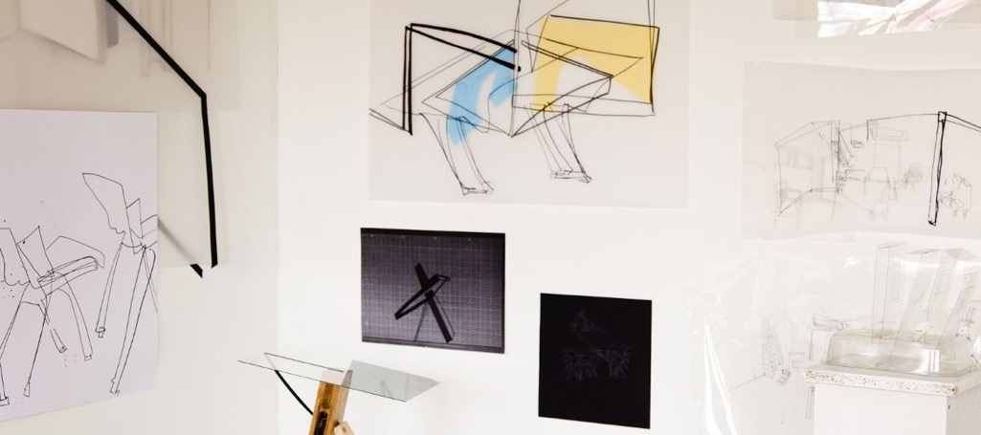
BA (Hons) FINE ART
WHAT YOU Do
Drawing
Painting
Sculpture
Art History
Photography
Print
Video
Professional Practice
Critical Theory
Notes:
Studio Practice
Art History
Drawing
Painting
Sculpture
Photography
Print
Mould-making
Video
Professional Practice
Critical Theory
and much more!

Slide 35
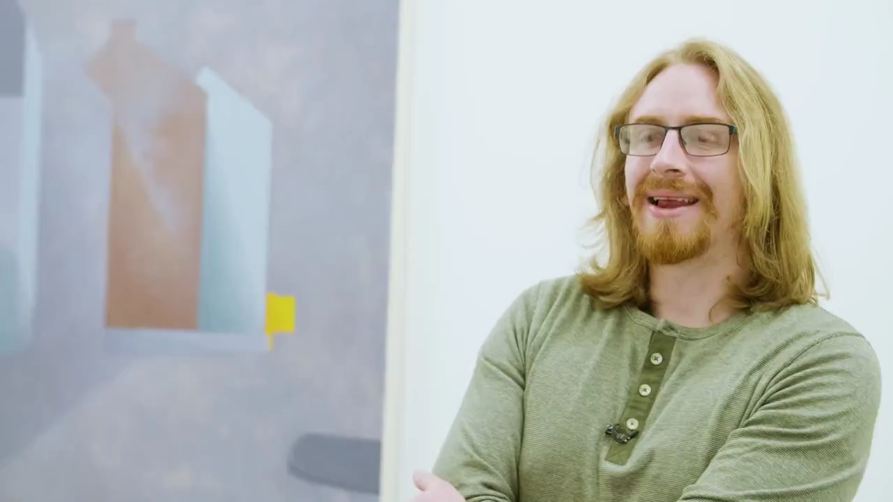
BA (Hons) FINE ART
FINAL
YEAR PROJECT
PAUL MCQUILLAN
Fine Art
My work considers the space and architectural forms found within the contemporary urban city environment. I explore notions relating to certainty and uncertainty that arises through the familiarity of lived-in spaces.

Slide 36
BA (Hons) FINE ART
Careers Opportunities
Independent Artist • Art Educator
• Curator • Sculptor • Print Maker
• Art Director • Community Arts Officer • Cultural Producer • Art Critic • Art Historian • Art Collection Manager • Entrepreneur

Slide 37
BA (Hons) FINE ART
GRADUATE Profile
Ciara Wall
Art Educator
“As Head of the Art department in Midleton College, my main focus is to provide my students with as broad an experience as possible within such a vast subject as Art. For me, Art has always been an outlet, somewhere I could express & create. Seeing my students’ growth as young artists and the joy it provides them, is very rewarding.”

Slide 38
BA (Hons) FINE ART
GRADUATE Profile
Sophie Behal
Visual Artist and Curator
Cork is a brilliant city to be a student in and Crawford is right in the middle of what’s going on. Being in such a supportive and inspiring environment is the best place to dedicate yourself to exploring your interests and making work.

Slide 39
BA (Hons) CONTEMPORARY APPLIED ART
(CERAMICS, GLASS, TEXTILES)
BA Contemporary Applied Art is an innovative interdisciplinary programme with an emphasis in three main material areas: Ceramics, Glass and Textiles, either as a chosen specialism, or in combination.
It offers students the opportunity to creatively develop and make objects. The emphasis is on an open and experimental exploration grounded in historical context and current critical debate about contemporary practice. trips.

Slide 40
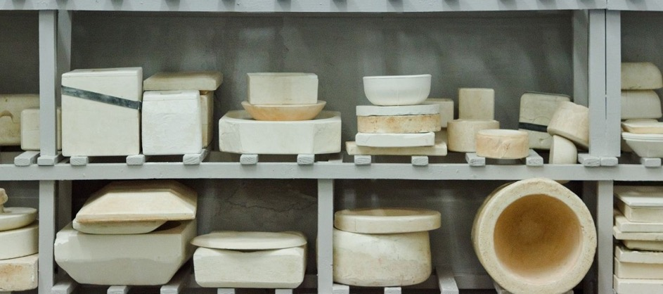
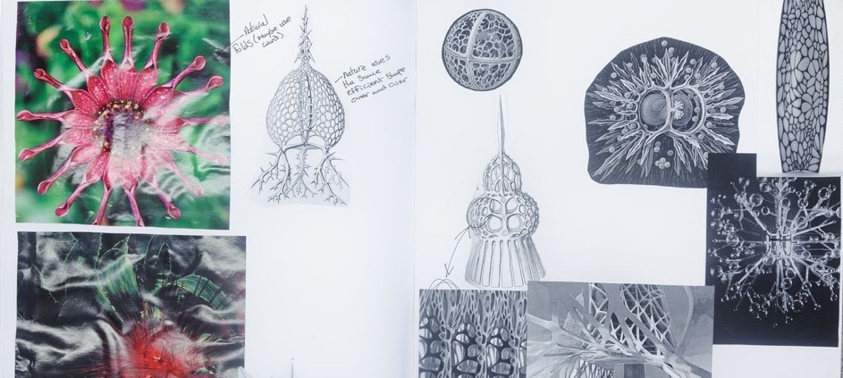
BA (Hons) CONTEMPORARY APPLIED ART
(CERAMICS, GLASS, TEXTILES)
WHAT YOU Do
Studio Practice
Applied Art History
Drawing
Ceramics, Glass
Textiles
Mould-making
Professional Practice,
Contemporary Applied Art Practice

Slide 41
BA (Hons) CONTEMPORARY APPLIED ART
(CERAMICS, GLASS, TEXTILES)
Career Opportunities
Exhibiting Artist / Maker • Craft Designer
• Community Arts • Curator • Arts Administrator •Gallery/Museum Professional • Teacher/Educator (requires further post-graduate study) • Textile Producer • Ceramicist •Technician • Art Professional • Sculptor • Entrepreneur

Slide 42
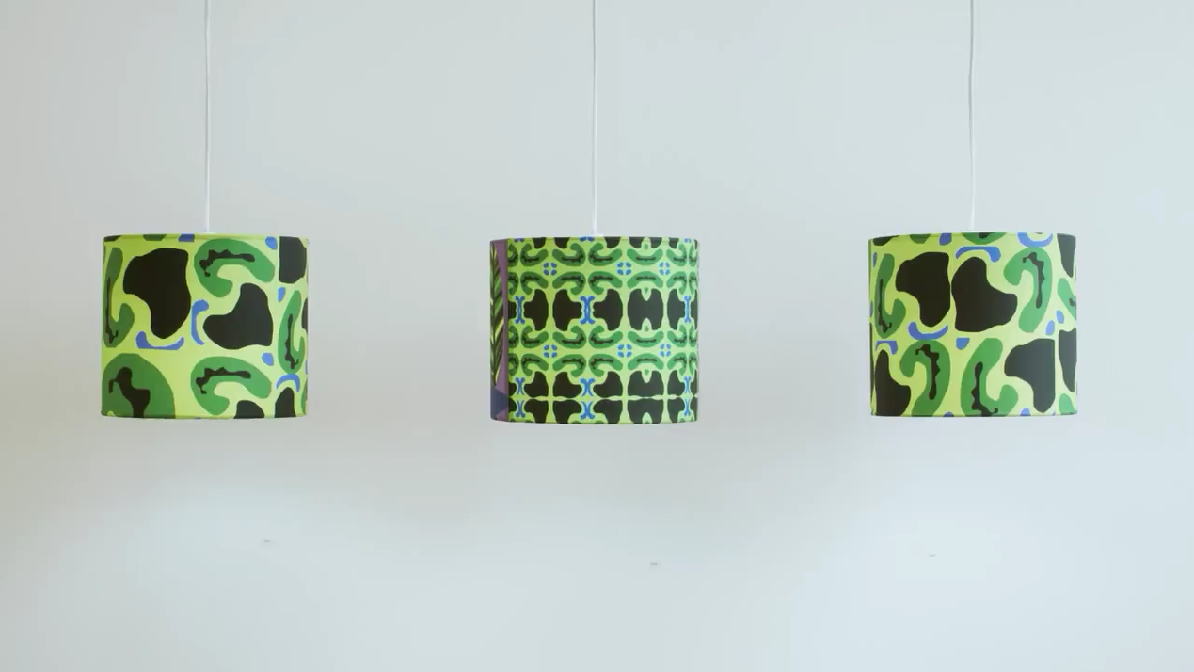
BA (Hons) CONTEMPORARY APPLIED ART
(CERAMICS, GLASS, TEXTILES)
FINAL
YEAR PROJECT
SÍOFRA HOLYLAND
Contemporary Applied Art
“My work has always dealt with the experimentation of colour and pattern. By using universal subject matters to generate my designs it has allowed my work to become more focused and refined. The main themes seen throughout my patterns is nature, growth and texture.”

Slide 43
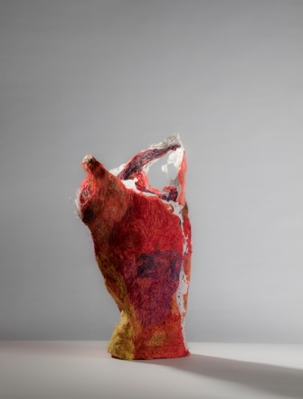
BA (Hons) CONTEMPORARY APPLIED ART
(CERAMICS, GLASS, TEXTILES)
STUDENT Profile
Helen O’Shea
Applied Artist
“Doing my degree has increased my confidence and professionalism as an artist. Easy to say but hard to describe how this has impacted all aspects of my practice. I now feel like an artist!
I am preparing to attend the Tresor Contemporary Art fair in Switzerland. Through exposure in college I have been invited to take part in the Discovery section, which hosts emerging artists not yet represented by galleries.”

Slide 44
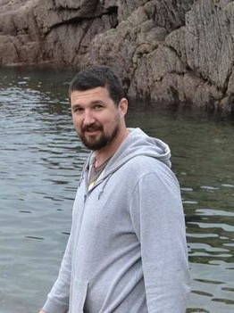
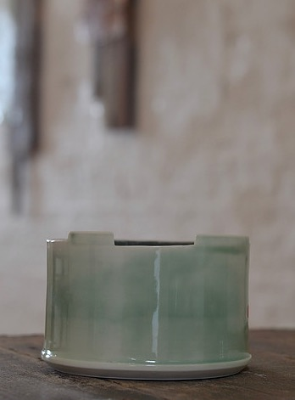
BA (Hons) CONTEMPORARY APPLIED ART
(CERAMICS, GLASS, TEXTILES)
STUDENT Profile
Luke Sisk
Applied Artist & Technician
“I am currently working as a part-time technician in the CCAD Ceramics Dept. as well as working on my own work, as a practising artist.
I am currently based in the Backwater Studios on Wandesford Quay, where I make both glass and ceramic pieces for exhibition, as well as working to commission on a regular basis.
After going to CCAD I realised that I am happiest when I’m making, and seeing other people enjoy what I make."

Slide 45
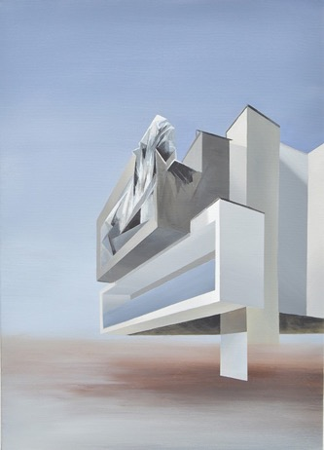
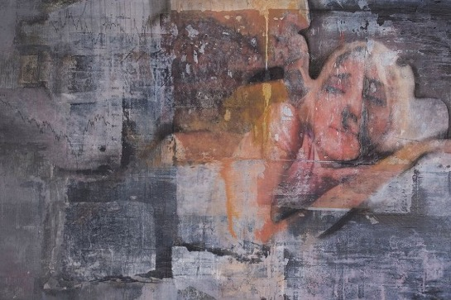

STUDENT SHOWCASE FINE ART & APPLIED ART

Slide 46

DEPARTMENT OF ARTS IN HEALTH & EDUCATION
MA IN ART THERAPY
PROFESSIONAL MASTERS OF EDUCATION
(ART AND DESIGN)
MA ARTS & Engagement

Slide 47


PROFESSIONAL MASTER OF EDUCATION
(ART AND DESIGN)
WHAT YOU WILL BE DOING
Through lectures and tutorials you will learn about the best practices involved in teaching art and design.
Workshops cover art and design disciplines such as drawing, painting, ceramics, textiles, sculpture along with graphic design, environmental design and digital media. This will provide you with the subject knowledge you will need to teach the second level Art and Design curriculum.

Slide 48

PROFESSIONAL MASTER OF EDUCATION
(ART AND DESIGN)
Career Opportunities
Second Level Art Teachers • Third Level Art Educators • Education Officers • Artists in Residence in Primary and Secondary Schools
• School Principals and Deputy-Principals
• Independent Art Education Policy Consultants and Researchers • Museum Curators • Youth Workers • Arts Officers

Slide 49


MA IN ART THERAPY
WHAT YOU WILL BE DOING
This masters programme leads to a professional qualification to practice Art Therapy in the form of therapeutic intervention with a wide variety of client groups. On completion graduates can register with the professional body for the Creative Therapies in Ireland, IACAT (Irish Association of Creative Arts Therapists). This course is delivered in our Grand Parade campus.

Slide 50

MA IN ART THERAPY
Career Opportunities
Art Therapist • Arts in Health • Arts in Social Care • Arts in Education • Community Artist

Slide 51


MA IN Arts & Engagement
WHAT YOU WILL BE DOING
This Masters prepares graduates to develop a professional practice in arts rich engagement with individual, group, and broader societal contexts. Participants on this Masters programme will develop an understanding of the role of the arts within learning, changemaking and the development of culture. This course is delivered in our Grand Parade campus.

Slide 52

MA IN Arts & Engagement
Career Opportunities
Artist Engaged in Community Issues • Arts in Health • Arts in Social Care • Arts in Education • Community Development • Gallery/Museum Education • Outreach Education • Professional Artist

Slide 53

Further details
For further details see
crawford.mtu.ie

